Slide 1

Jeopardy! Tutorial
This template is ready to use but since Jeopardy! is a quiz show, you can change the questions and answers of the template, in order to adapt the game to your topics.
Please do not delete whole slides, otherwise we can not guarantee a smooth game experience and problems may occur.
However, you can change texts, the music and colours. In the next slides we will give you a detailed explanation to learn how to play the game and adapt it to your ideas.
Have a lot of fun with our JEOPARDY! game!

Slide 2
Rules of Jeopardy!
To start the game, click on the first Jeopardy! Slide and start the presentation by clicking on the menu Slide Show > From Current Slide.
Now the intro with music starts playing and you only must click one more time to run the begin animation. When the second money board appears, the first player can choose the category and money- value by clicking on the field. (With the increasing amount of money, the difficulty of the questions also increases!)
As soon the question appears, the players have 30 seconds to think about it. (until music ends) When one person raises his arm (or shouts) he/ she can answer. Answers must be phrased as questions, unless it’s said differently.
Right answer? Then the player gets the amount of money, the question is worth. Take a sheet and write down the value to the persons' name. If he guessed it wrong, the other players could try their luck. If time runs out, or no one got it, no one will get any points. The person with the highest amount of money, wins.
Advanced version: guessing it wrong will subtract the amount of money from the players account; negative values are also accurate.

Slide 3
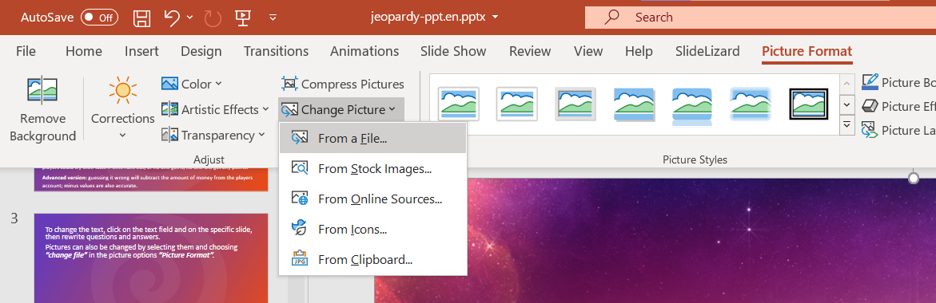

To change the text, click on the text field on the specific slide, then rewrite questions and answers.
Pictures can also be changed by selecting them and choosing “From a File” in the picture options “Picture Format”.
Some pictures are hidden behind other elements. In order to change them, move objects around and bring them to the front or back by right-clicking them and choosing the option.

Slide 4

More information can be found on our blog:
https://slidelizard.com/blog/jeopardy-powerpoint-template

Slide 6


“What would JOSH Say“ EDITION
PLEASE CLICK TO START THE GAME!

Slide 7








Slide 8


Slide 9


AUBREE
(SHE‘S A FINE GIRL)

Slide 11

RAMBLIN‘
MAN

Slide 13
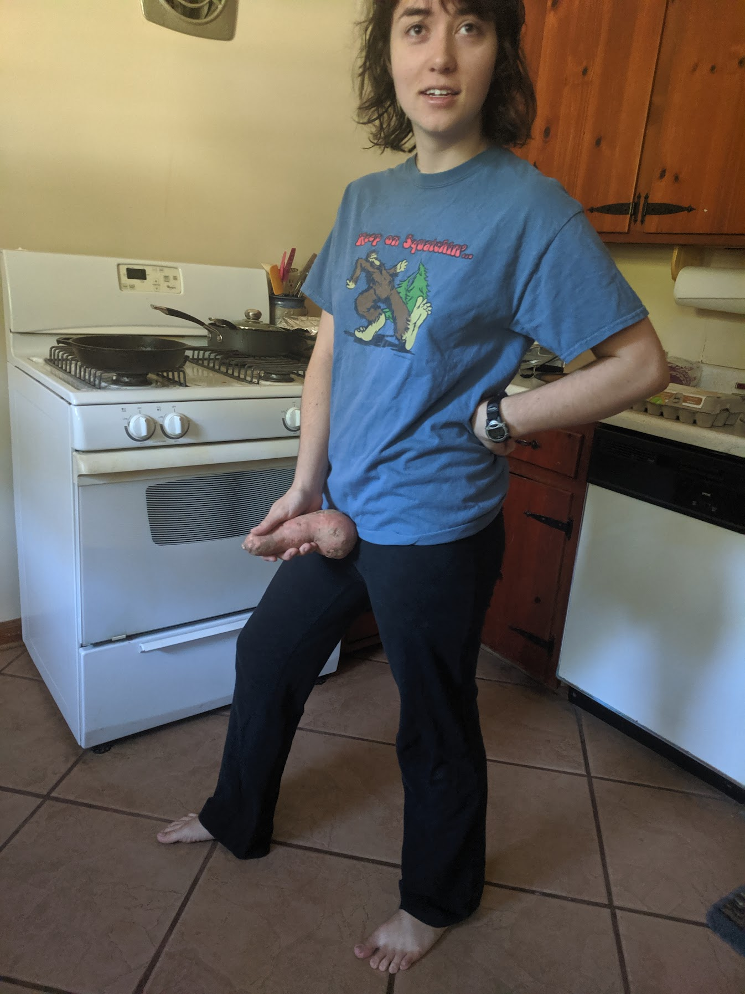
SUPER FREAK

Slide 15
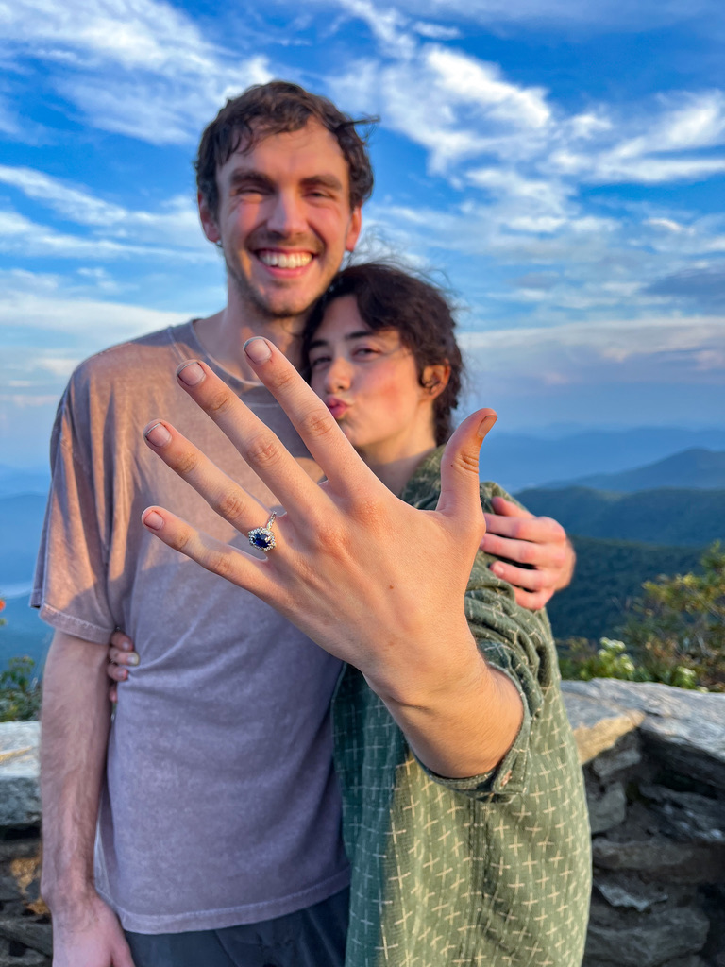
LET‘S GET IT ON

Slide 17

ME N JULIO DOWN BY THE SCHOOL YARD

Slide 18
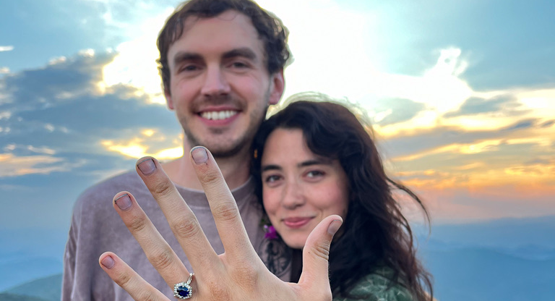
RAMBLIN‘ MAN
SUPER FREAK
LET‘S GET IT ON
ME N JULIO DOWN BY THE SCHOOL YARD
AUBREE (SHE‘S A FINE GIRL)
YOU FINISHED THIS GAME

Slide 19
WHAT SONG WAS AUBREE NAMED AFTER?
Click here for the answer

Slide 20
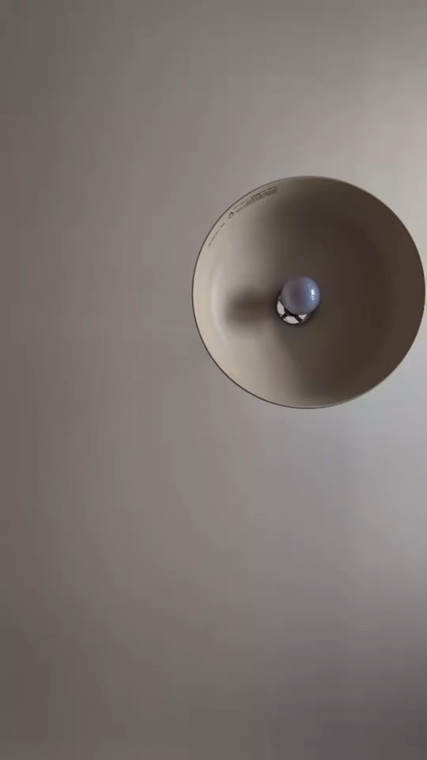
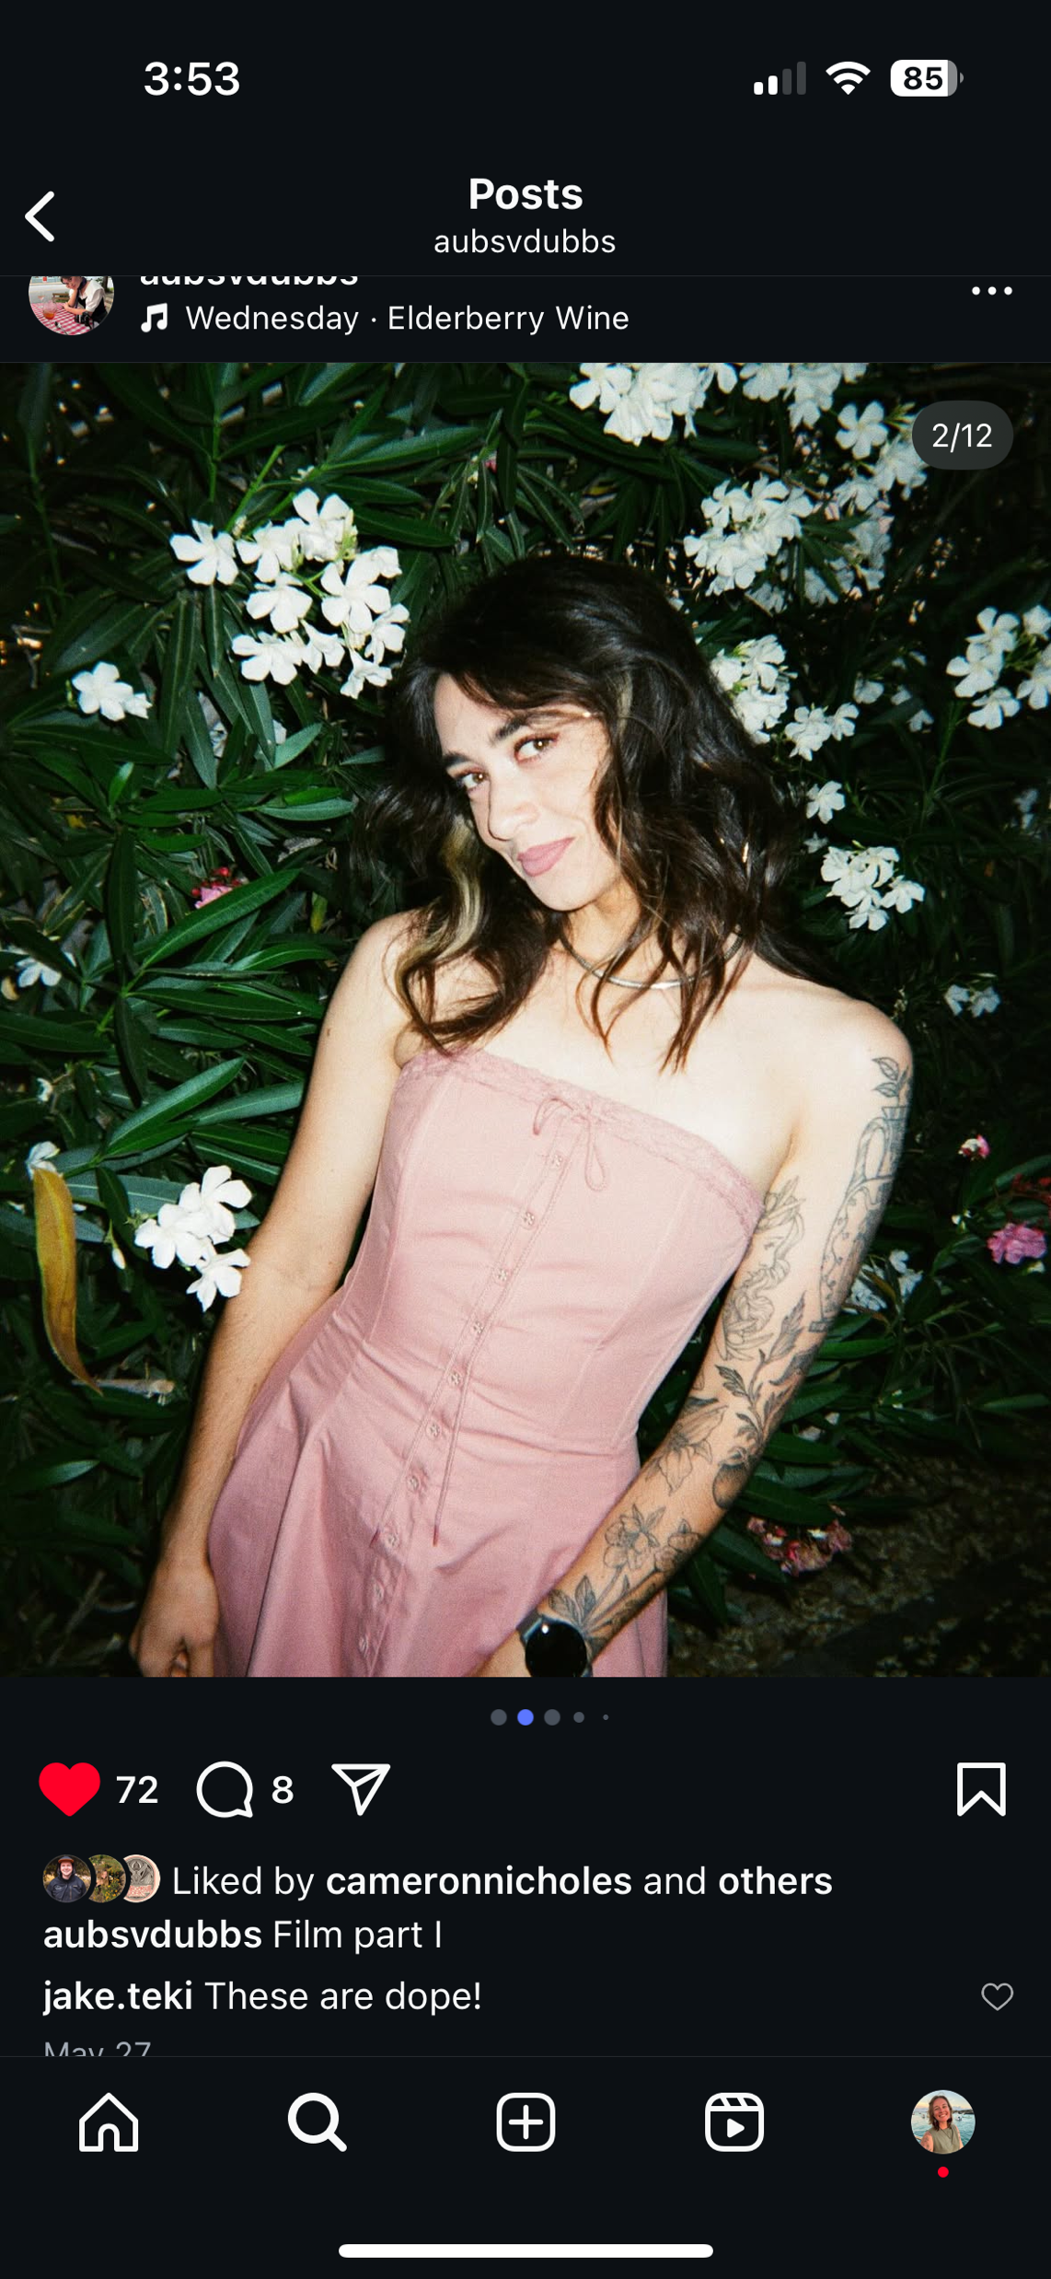
1s

Slide 21
WHAT IS HER DREAM CONCERT?
Click here for the answer

Slide 22
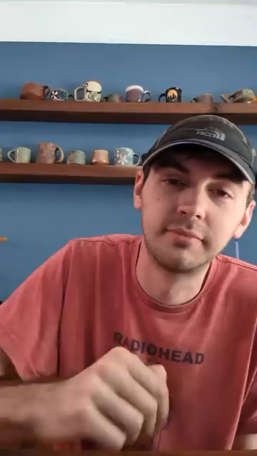
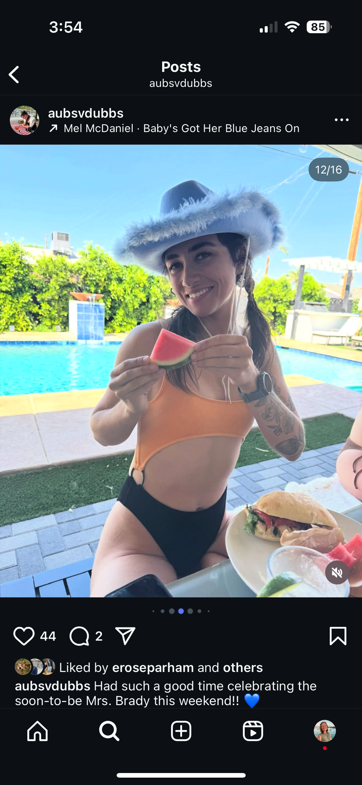
2s

Slide 23
WHAT FOOD IS HER GUILTY PLEASURE?
Click here for the answer

Slide 24
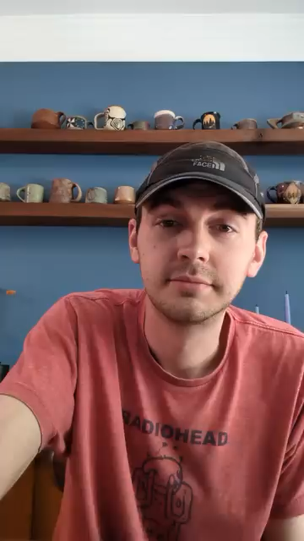
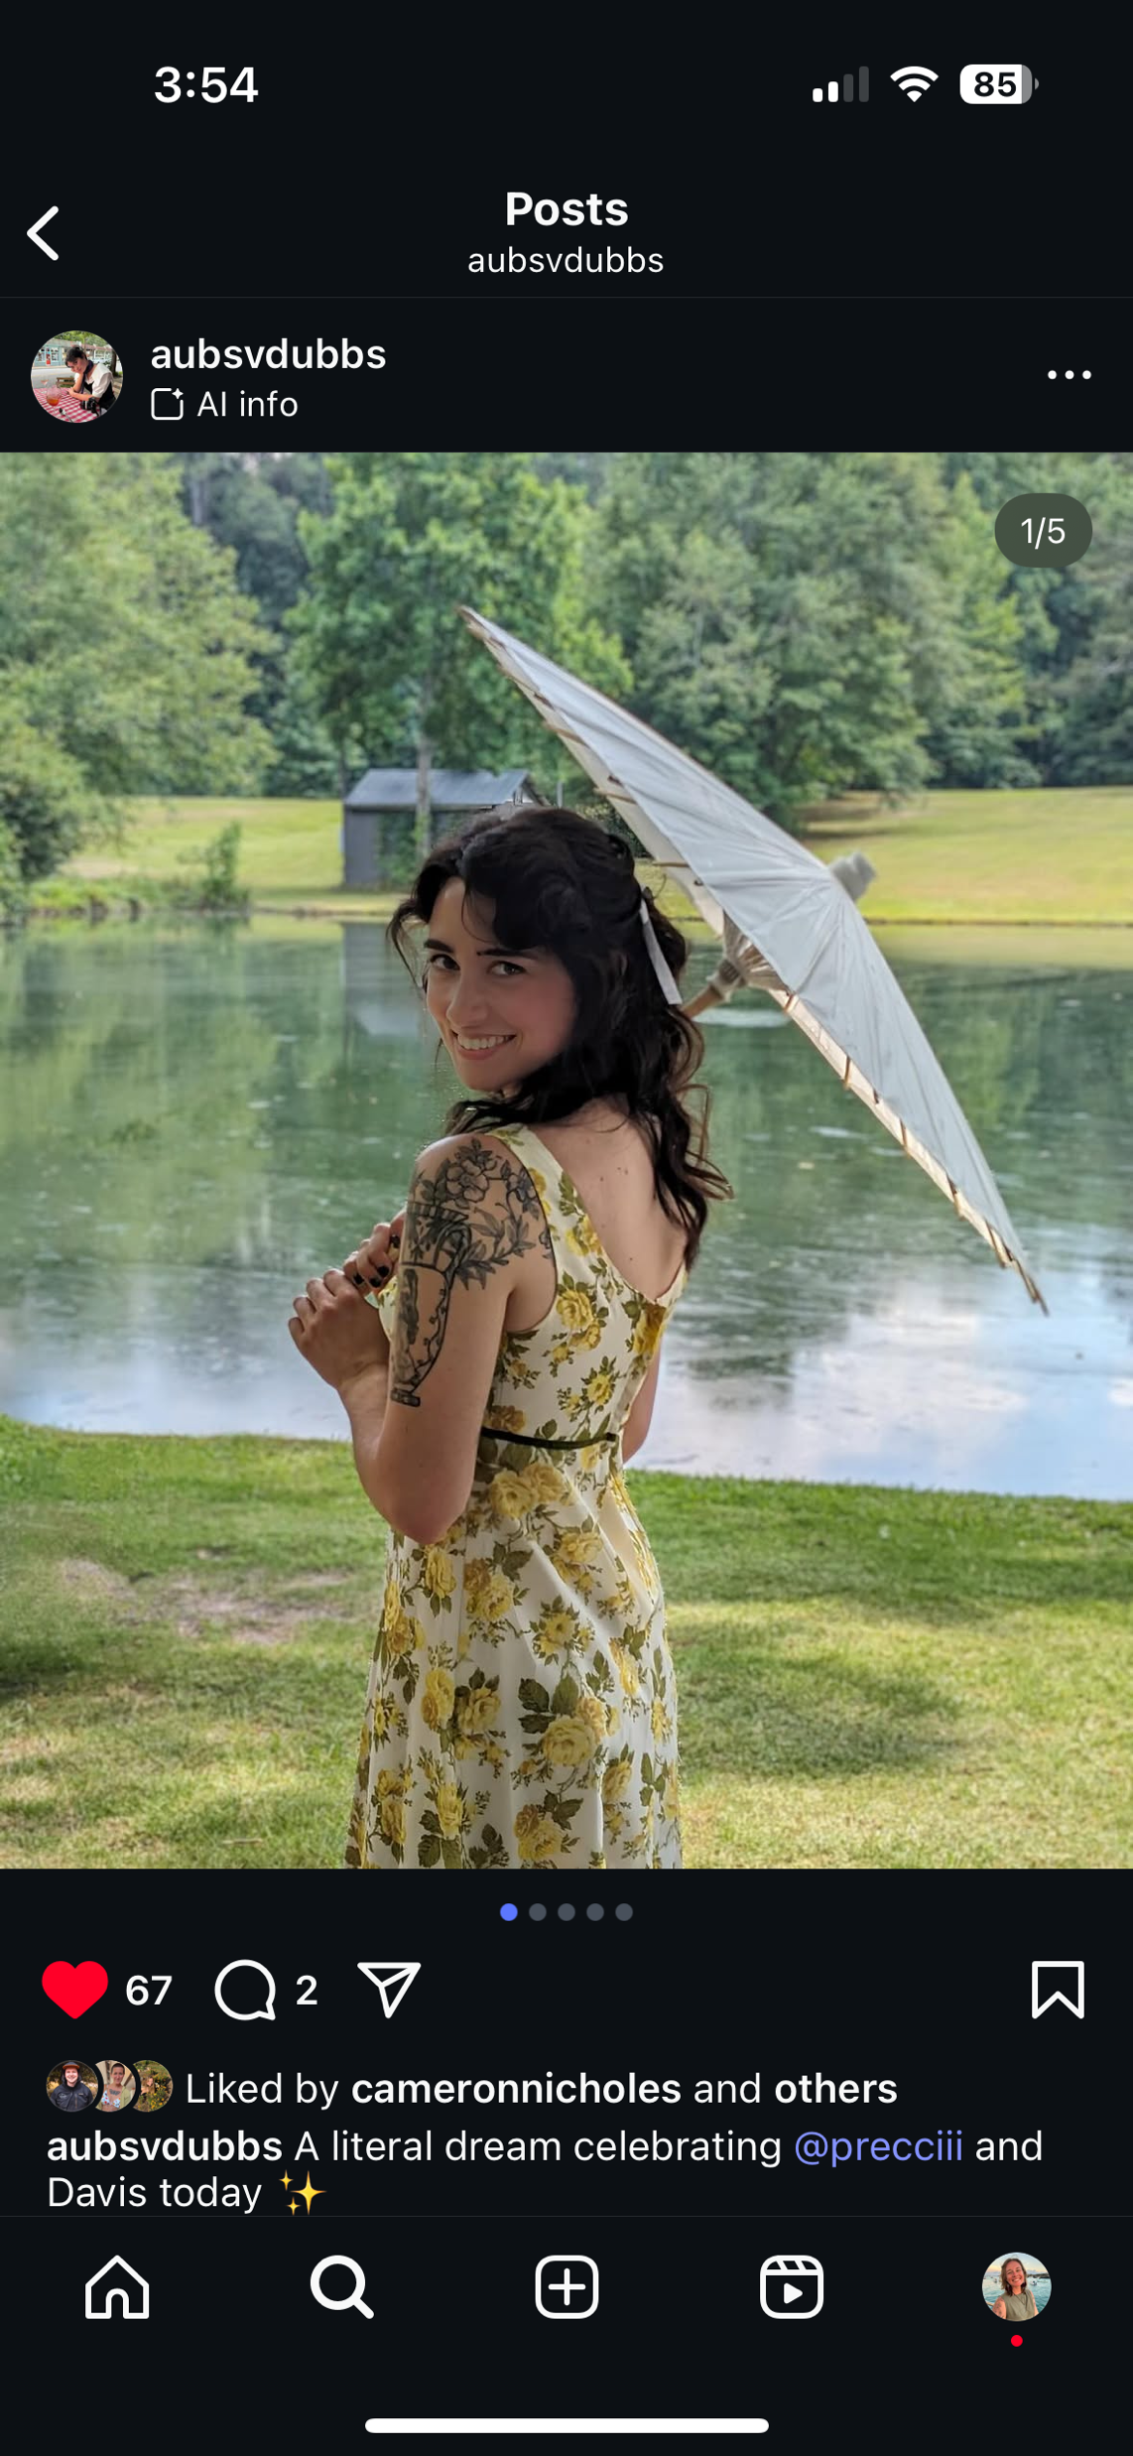
3s

Slide 25
AS A KID, WHAT DID SHE WANT TO BE WHEN SHE GREW UP?
Click here for the answer

Slide 26
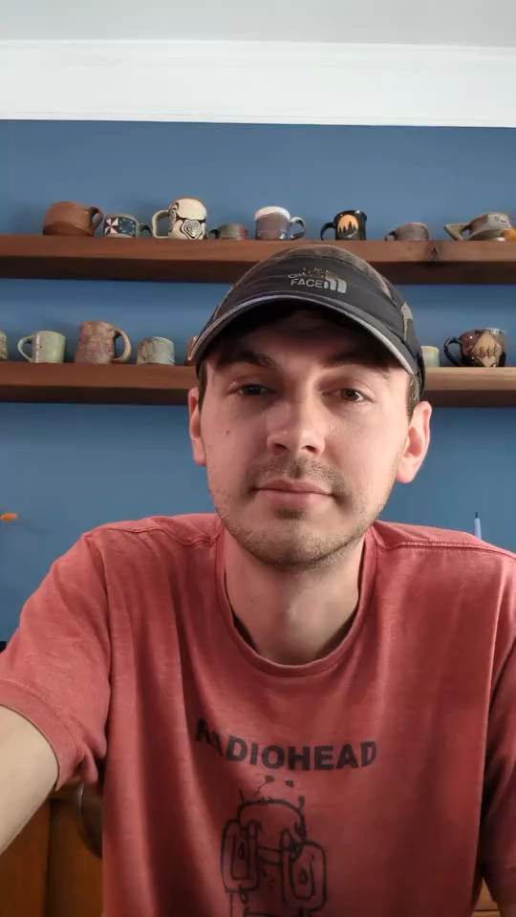
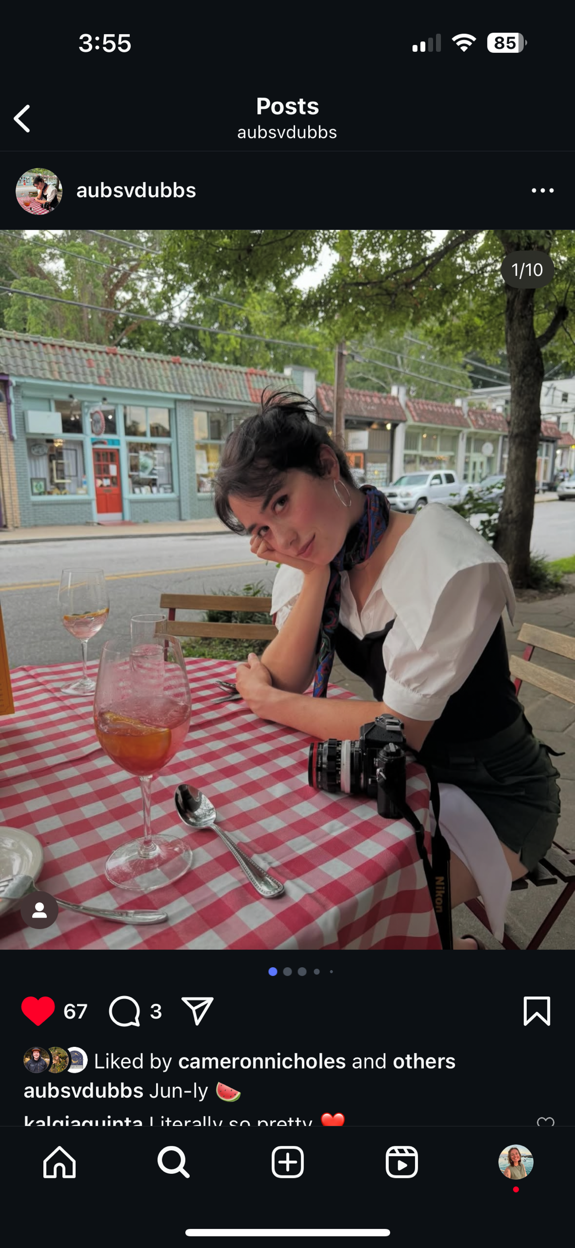
5s

Slide 27
DESCRIBE WHAT AUBREE FIRST THOUGHT OF JOSH IN ONE WORD.
Click here for the answer

Slide 28
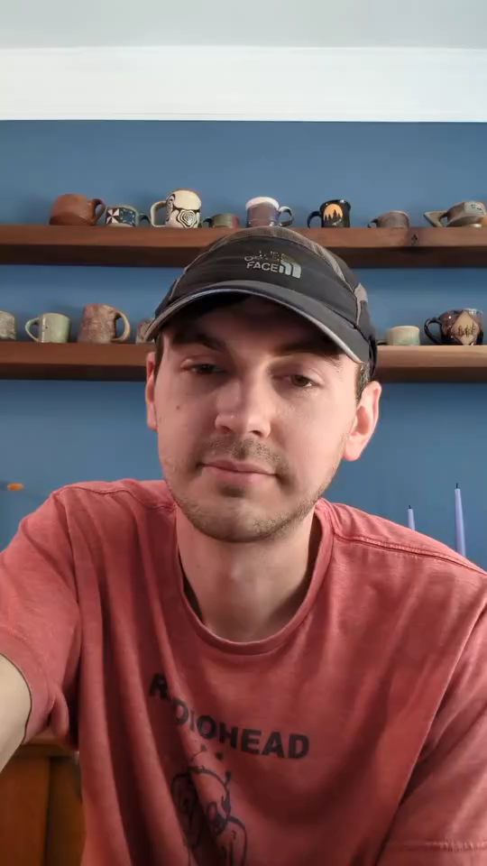

1s

Slide 29
WHO IS JOSH‘S CELEBRITY CRUSH?
Click here for the answer

Slide 30
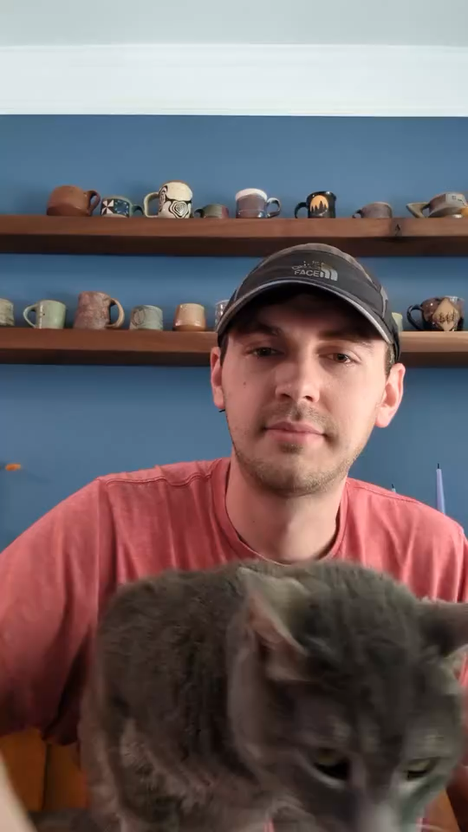

2s

Slide 31
WHAT IS AUBREE’S FAVORITE QUALITY OF JOSH’S?
Click here for the answer

Slide 32
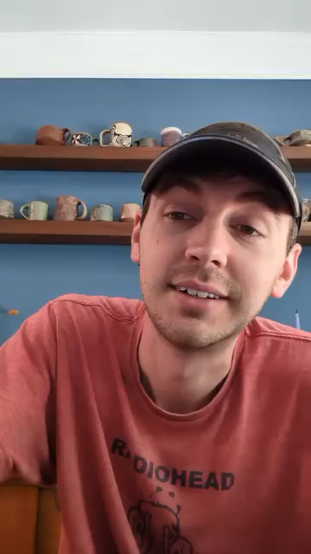

3s

Slide 33
IF JOSH EVER WON THE LOTTERY, WHAT’S THE FIRST THING HE WOULD SPEND IT ON?
Click here for the answer

Slide 34
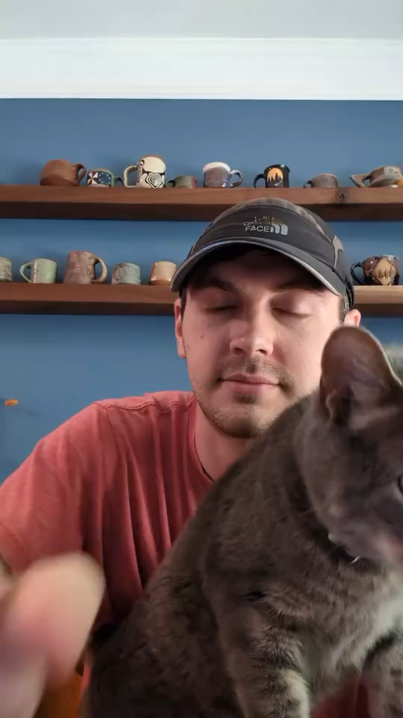

5s

Slide 35
WHO MADE THE FIRST MOVE?
Click here for the answer

Slide 36
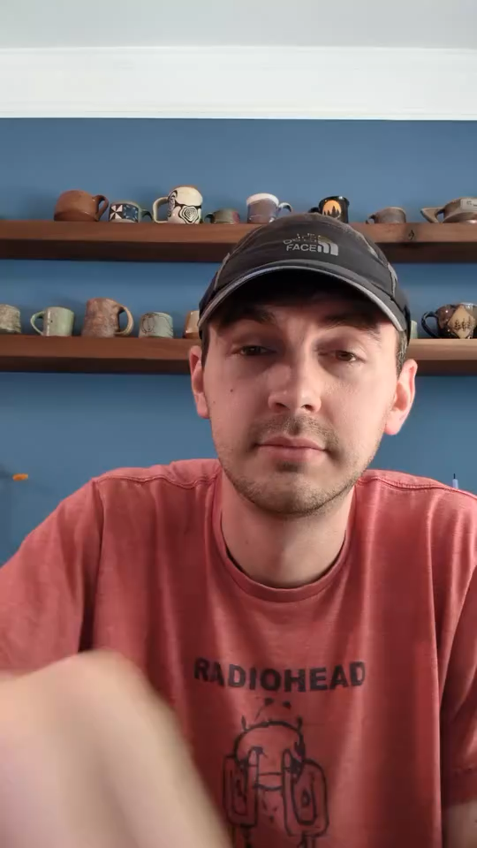

1s

Slide 37
WHO IS AUBREE’S CELEBRITY HALL PASS?
Click here for the answer

Slide 38
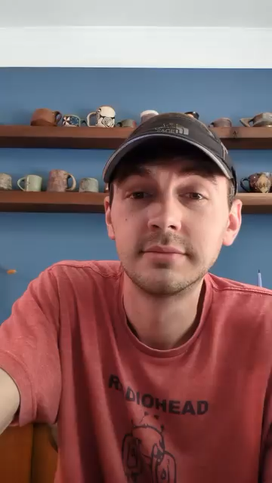

2s

Slide 39
DAILY DOUBLE
Where is the first place Aubree jumped Josh’s bones?
Click here for the answer

Slide 40

Josh’s family cabin?
3s

Slide 41
WHAT IS JOSH‘S FAVORITE QUALITY OF AUBREE‘S?
Click here for the answer

Slide 42
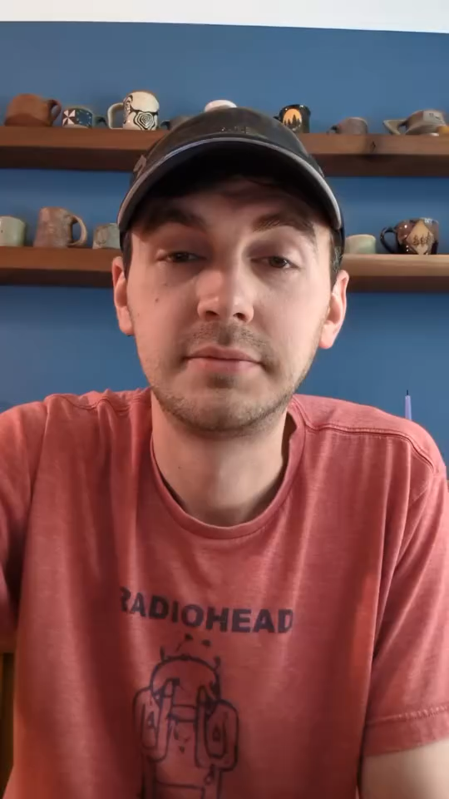
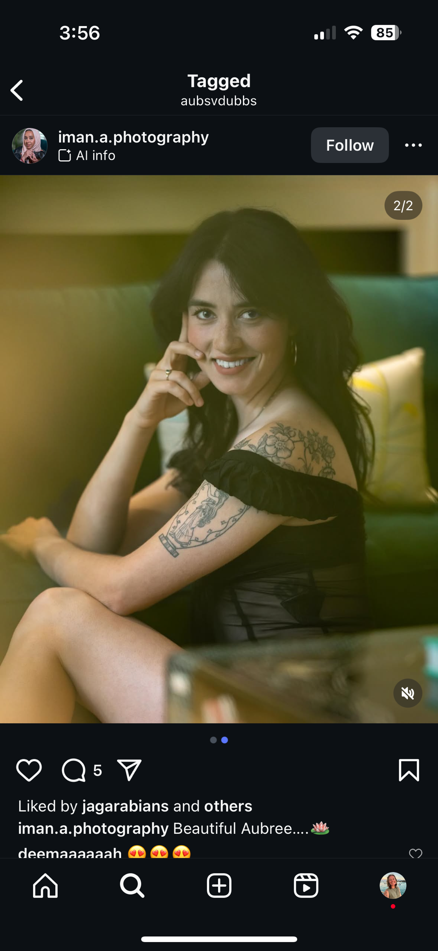
5s

Slide 43
WHERE DID AUBREE AND JOSH MEET?
Click here for the answer

Slide 44
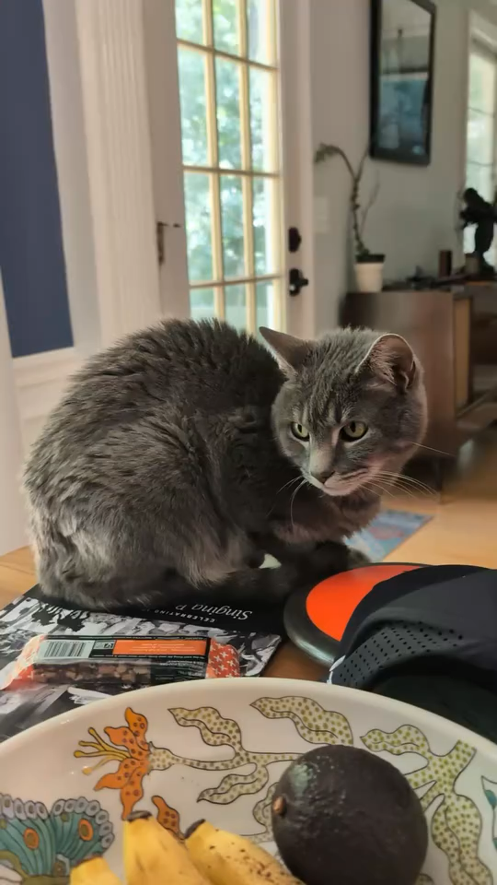

1s

Slide 45
WHAT WAS THEIR FIRST DATE?
Click here for the answer

Slide 46
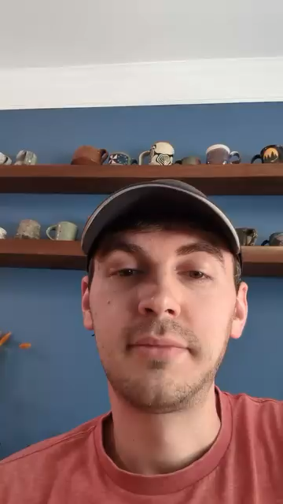

2s

Slide 47
WHO CLEANS THE HOUSE MORE?
Click here for the answer

Slide 48
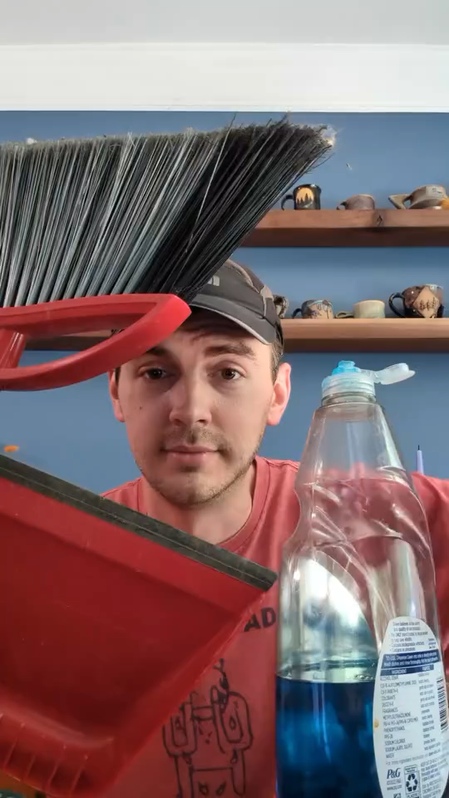

3s

Slide 49
IF YOU WERE BOTH IN A BAND, WHAT WOULD THE NAME BE?
Click here for the answer

Slide 50
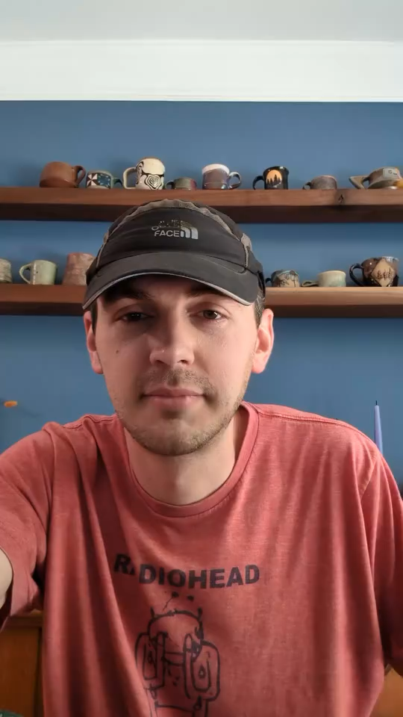

5s

Slide 51
AUBREES GO-TO KARAOKE SONG?
Click here for the answer

Slide 52
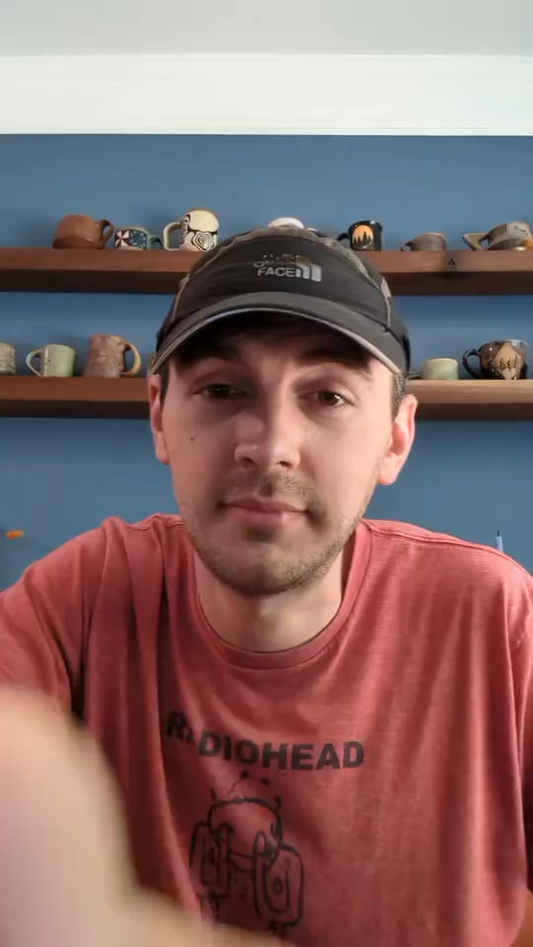
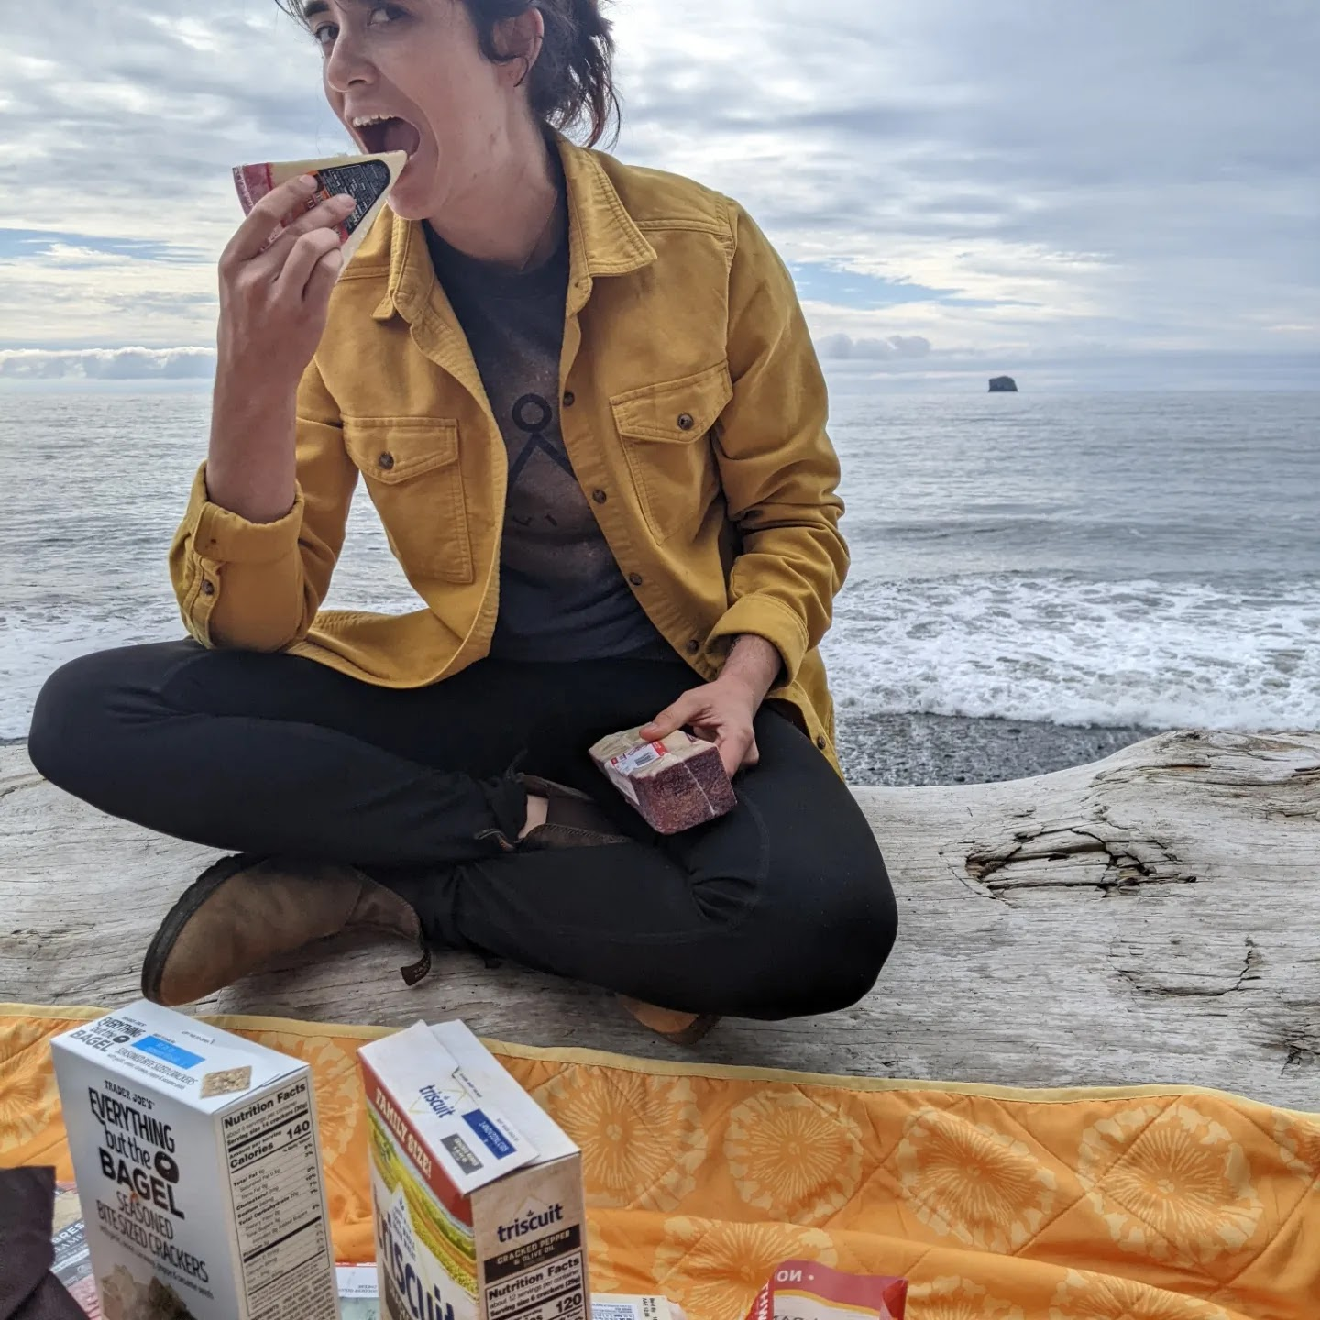
1s

Slide 53
WHAT’S THEIR FAVORITE NICKNAME FOR CAT?
Click here for the answer

Slide 54
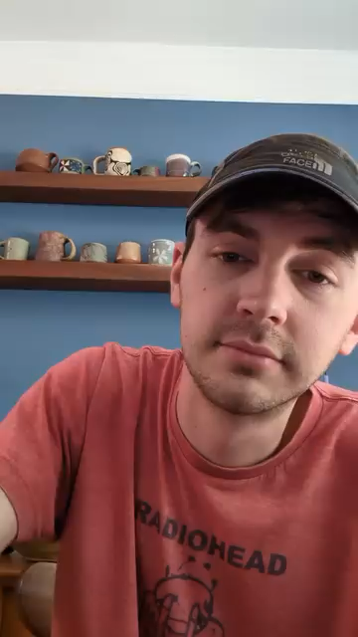
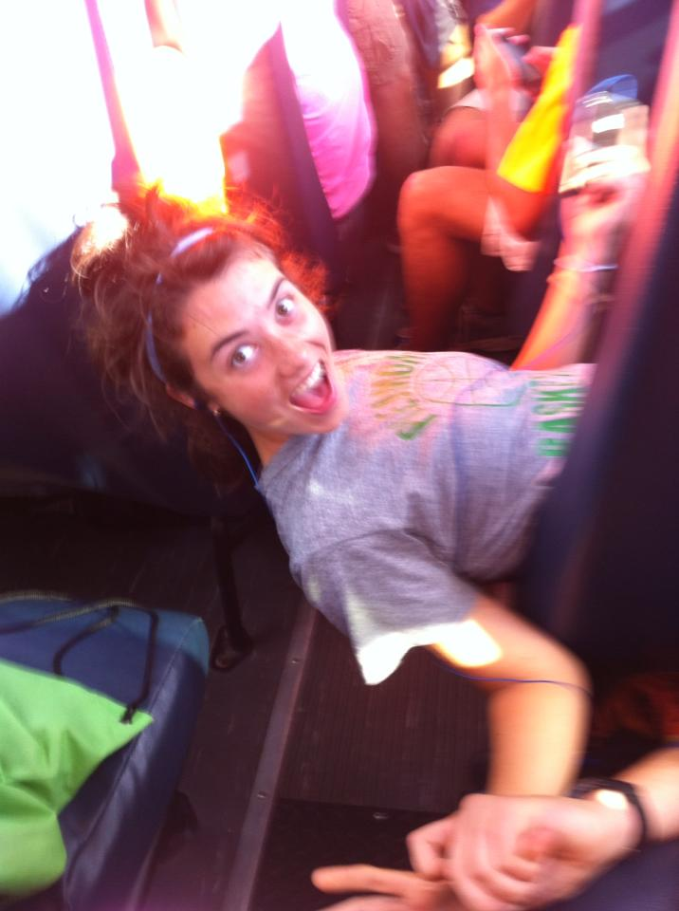
2s

Slide 55
IF JOSH WAS AN ANIMAL, WHAT WOULD HE BE?
Click here for the answer

Slide 56
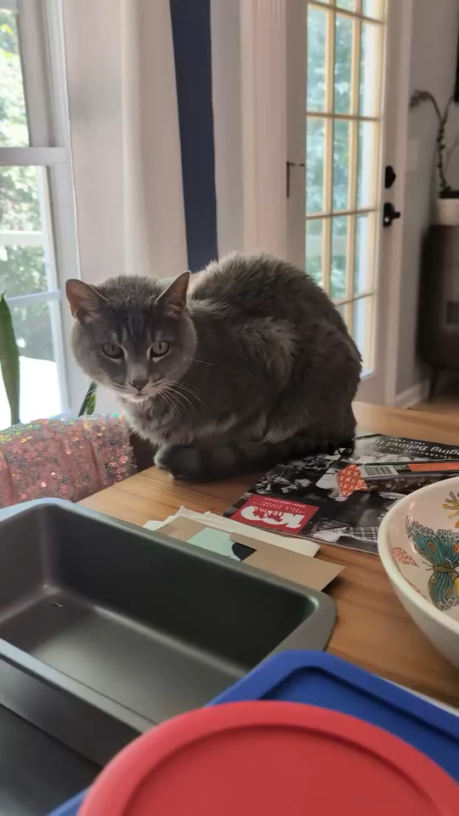
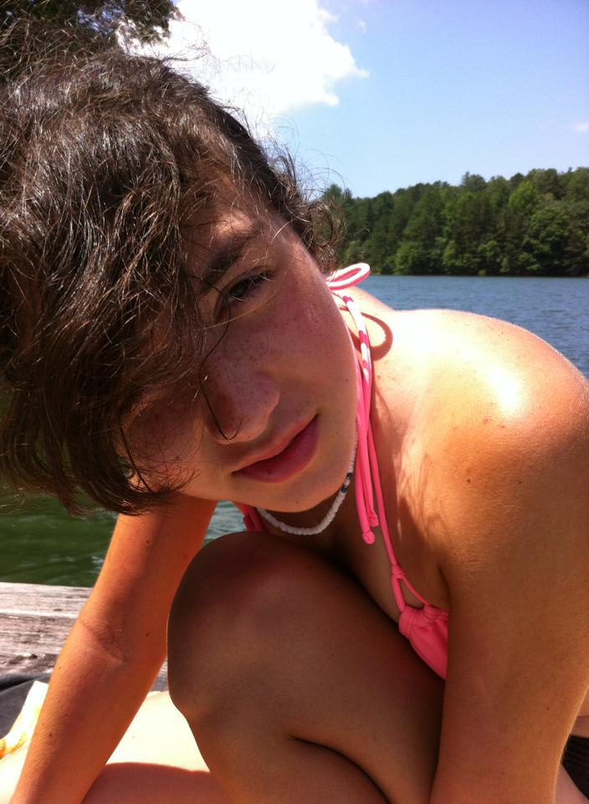
3s

Slide 57
IF YOU GOT A CALL AUBS WAS IN JAIL, WHAT WOULD THE CRIME BE?
Click here for the answer

Slide 58
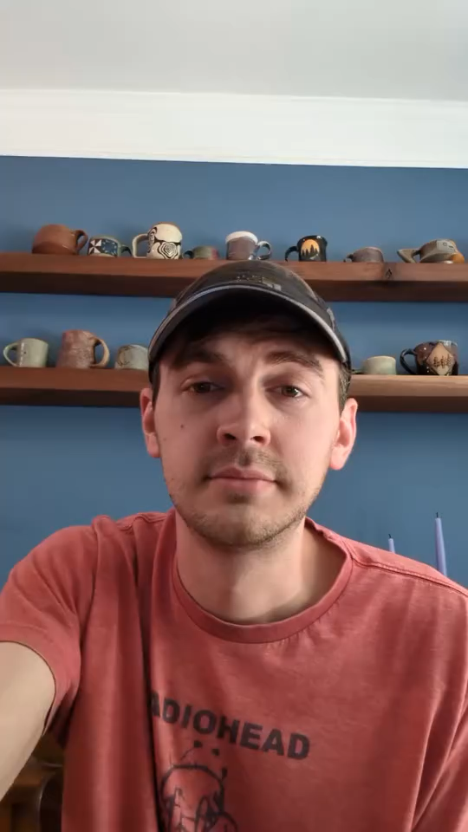
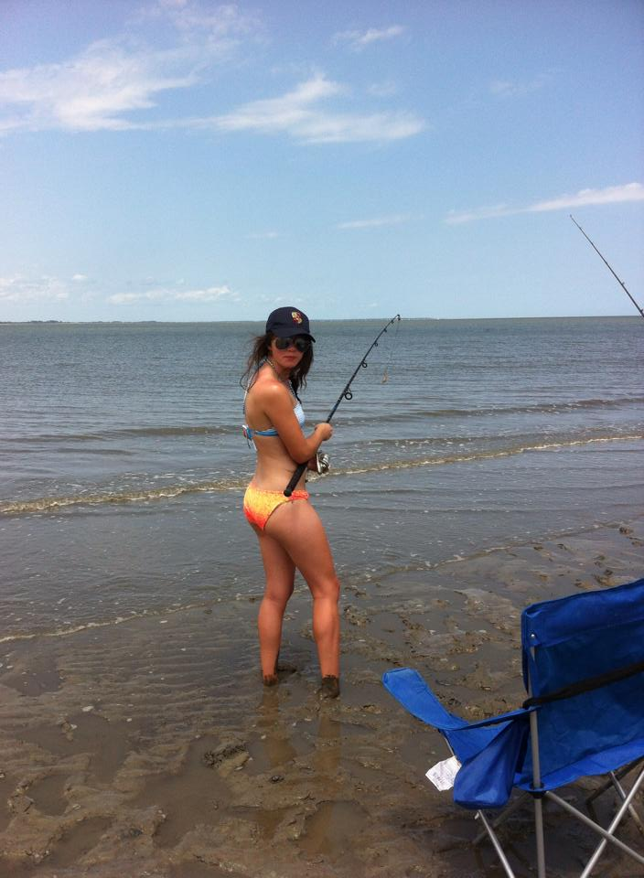
5s

Slide 59
1s
5s
2s
3s
4s

Slide 60


Free Download:
https://slidelizard.com

